Slide 1
EV Sentiment Analysis
Josh Everts, Xuan Jiang
Notes:
We are trying to predict sentiment about electric vehicles from news headlines and/or articles. However, journalists often aim for a neutral or balanced discussion. Have you thought about how to adress this? You could look at alternative data such as comments in online forums Reddit (Pushshift API) or comments below articles on news sites.

Slide 2
Question and Motivation
Research Question: Are there sentiment and/or topic differences between News coverage of Electric Vehicles (EVs) and EV owner/user reviews.
Hypothesis: Yes, we think there are differences in sentiment between these groups.
Additionally:
Can NLP help us question and/or confirm our hypothesis or bring to light new possibilities we haven’t considered?
Could this analysis help to indirectly observe what the major avenues and barriers to widespread EV adoption may be?
Notes:
Our main goal for the project involves determining whether there are sentiment or topic differences between news and consumer reviews related to EVs.
applying NLP techniques to perform a news and user-review- based analysis of Electric Vehicle (EV) sentiments.
In addition to providing a comparison between the sentiments and topic distributions of news media and consumers with regard to EVs, we also hope this project will help to indirectly observe what the major avenues and barriers to widespread EV adoption may be. Some examples of barriers could include ”range anxiety” or ”lack of charging infrastructure” while avenues could include ”convenience” or ”acceleration.”

Slide 3
Our News and Consumer Data
News Data
Bloomberg, CNBC, Reuters, WSJ, Fortune
https://www.kaggle.com/jeet2016/us-financial-news-articles [1]
Collected January-May 2018
Filtered for EV-related bi-grams in article text
After filtering: ~1700 articles
Consumer/User Data
Scraped from InsideEVs.com Tesla Model 3 Forum: 'https://www.insideevsforum.com/community/index.php?forums/model-3.32/' [2]
~1900 comments from ~280 threads.
Notes:
This kind of understanding is especially relevant in a time where discussion of EVs in the media often dominates that of gasoline cars, yet EVs made up only 1.7 percent of US vehicle sales in 2020[1]. Furthermore, some studies like that of Song et al.(2021) have focused more on attitudes towards autonomous-vehicles (AVs) and rural areas. Therefore we believe a comparison-based topic and sentiment analysis of nationwide or global EV text data could be a useful extension of previous work.
Perform A/B significance testing on the topic/term frequencies we find in order to verify if there is truly a difference
In order to determine sentiments we plan to use the semi-supervised Se- mAxis [15] technique previously used in the homework.

Slide 4
Approach and Methods
Collect and Filter Data
SemAxis [3] Model
Gensim Topic Model
News Dataset: Filter with bi-gram term dictionary
Pre-trained GloVecs
Tokenize on News and Review Corpora with K=10
Corpus-trained word2vec
Consumer Reviews: Scraped from insideEVs.com Tesla Model 3 Owners Forum
Decide on positive/negative sentiment vectors using test embeddings
SemAxis Analysis of Topic Tokens
Find average token-wise sentiment for each corpus

Slide 5
Results -- Sentiment Analysis
GloVe embeddings vs word2Vec corpora embeddings flip the sentiment order -- this suggests that our analysis is highly dependent on embedding and semantic vector choice.
Significance
Note: SemAxis produces scores between [-1,1]
Model | News Score | Comments Score | Significance (t-test)
gloVe | .0496 | .0167 | P < .0001
word2Vec | -.035 (news-com) | -.012 (com-com) | P < .0001
Conclusion: we found that the two corpora have statistically different sentiments in both an unsupervised and semi-supervised case. But the practical significance is very low as seen by the near-0 sentiments over each corpus.

Slide 6
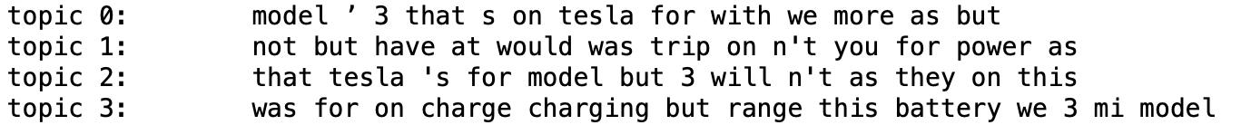
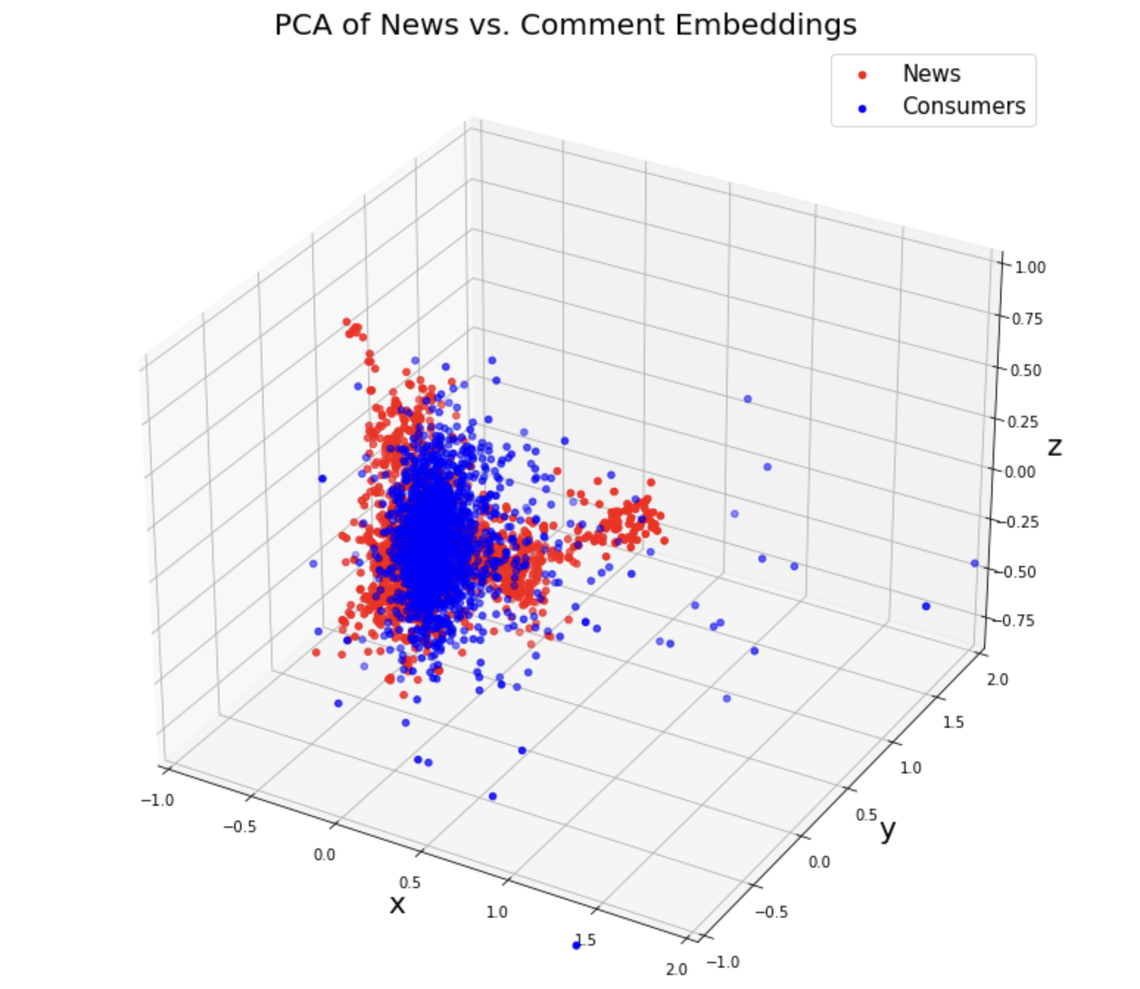
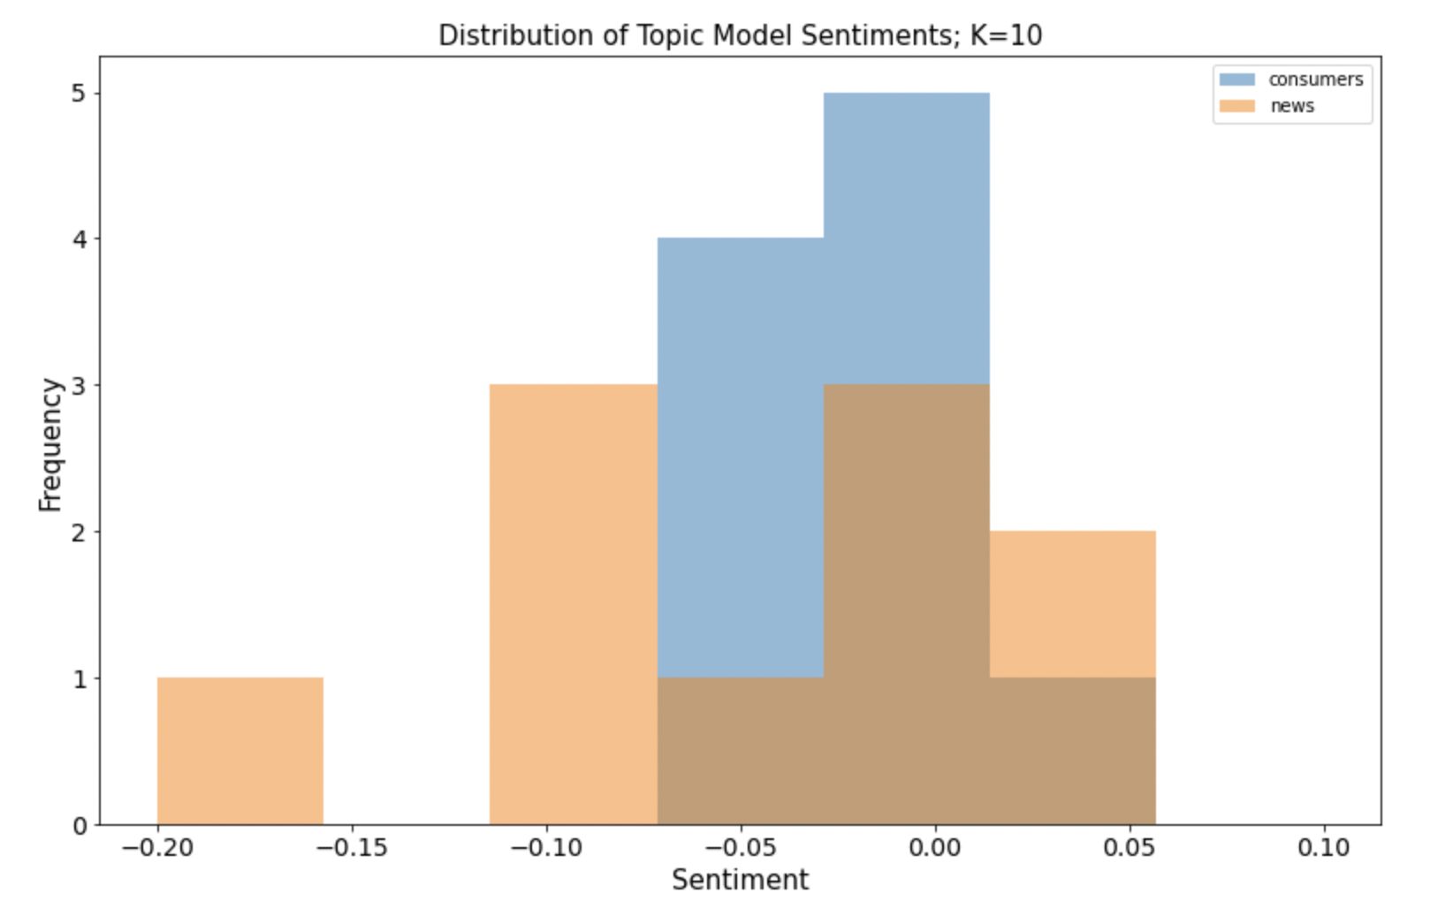
Results -- Topic Model and Sentiments
News
Consumers

Slide 7
Conclusions
Summary
Next Steps
There is a statistically significant difference in sentiment between Tesla Model 3 Owners and business-news headlines, though it is very small in magnitude. Does it generalize?
Topic Models reveal big differences in discussions; consumers discuss a variety of issues that are hard to capture in a single sentiment.
We each performed our own test-labelling of 100 random forum comments with a positive, negative, or neutral sentiment. We obtained moderate agreement with a Cohen’s Kappa = 0.521.
This suggests that a supervised sentiment-classification method using BERT is a good next step.
Generally need more data, and will add non-Tesla forum comments.
Remove repeat text in forum comments using sequence alignment.

Slide 8
Questions?

Slide 9
Data and References
Sources
Data From:
[1]: Jeet.J. “US Financial News Articles.” Kaggle, 5 Sept. 2018, https://www.kaggle.com/jeet2016/us-financial-news-articles.
[2]: Inside EVS Forum, https://www.insideevsforum.com/community/index.php?forums%2Fmodel-3.32%2F.
References:
[3]: An, Jisun, et al. “Semaxis: A Lightweight Framework to Characterize Domain-Specific Word Semantics beyond Sentiment.” Proceedings of the 56th Annual Meeting of the Association for Computational Linguistics (Volume 1: Long Papers), 2018, https://doi.org/10.18653/v1/p18-1228.

